Slide 1
American Sign Language (ASL-2)
Project Presentation
Team: Joaquin Calilao, Bardan Kafle, Rajjya Paudyal, Ali Ahmed

Slide 2
Project Objective
Develop an American Sign Language (ASL) interpretation device
Convert ASL gestures into text and sound
Motivation:
Facilitate communication between deaf and non-sign language users
Notes:
Our goal is to develop and asl interpretation device that can convert asl gestures into text and audio. The purpose of this is to help communicate between visual and spoken language users. Our completion date target is May 2025

Slide 3
Agenda
Review first semester demo progress
Inspect Design (Hardware & Software components)
Demonstrate all signs w/speaker functionality
Verify design meets requirements
Discuss any challenges or future improvements

Slide 4
Last Demo
No gestures implemented
Sign accuracy -> 77%
Timing was met at 2-5ms per translation
No Housing
No GUI
No Text-to-Speech implemented
Letters/numbers with the same hand sign were not handled in software

Slide 5
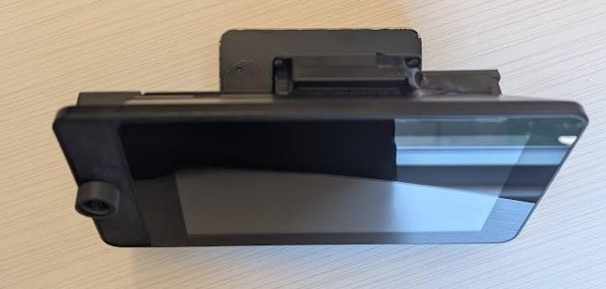
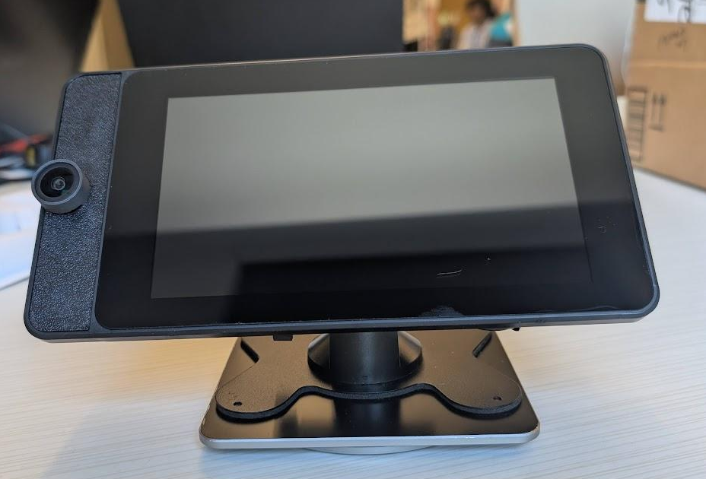
Final Build: Top and Front
Camera
Rotating Plate

Slide 6
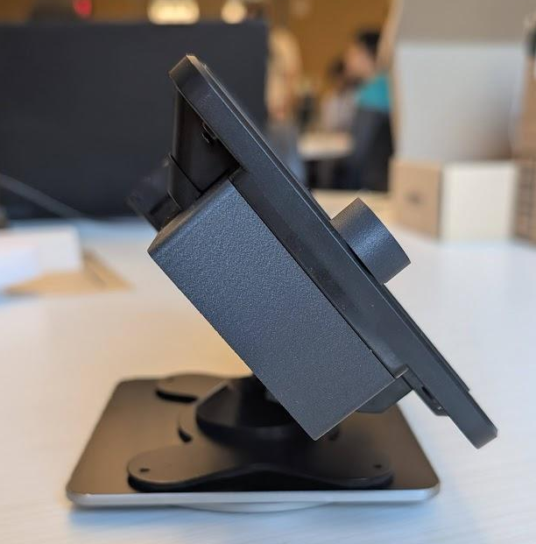
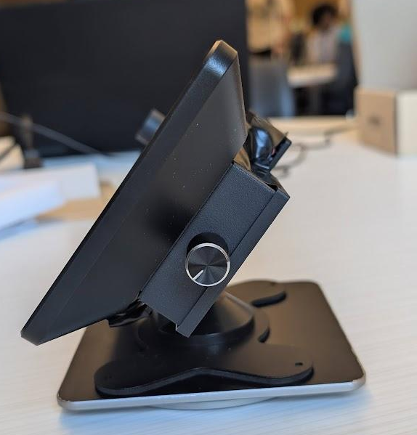
Final Build: Left and Right
Audio Ctrl.
Port Cover

Slide 7
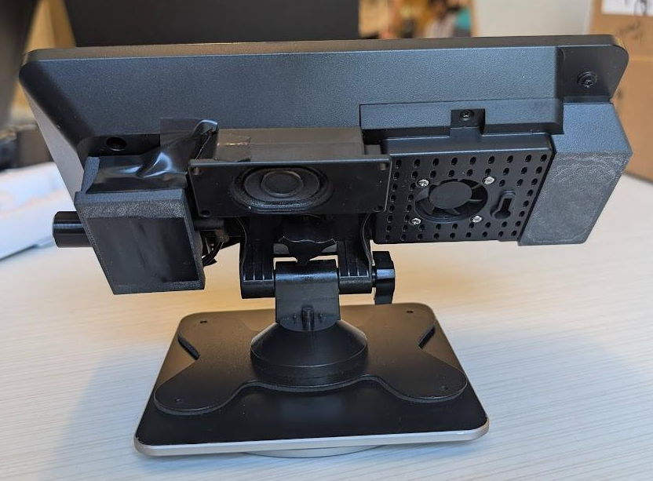
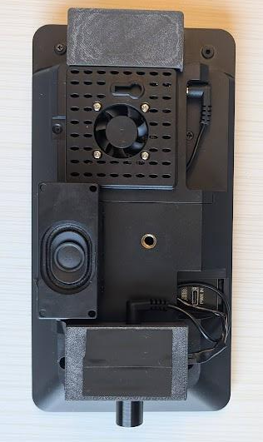
Final Build: Back
Speaker
Port Cover
Audio Ctrl.

Slide 8
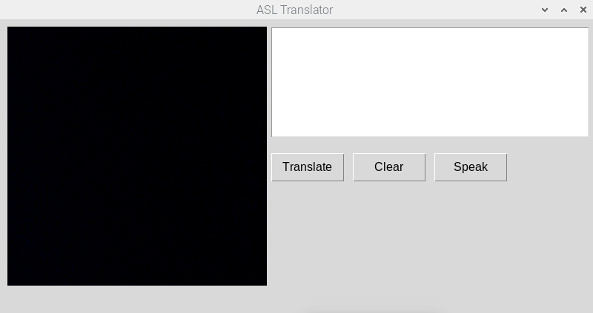
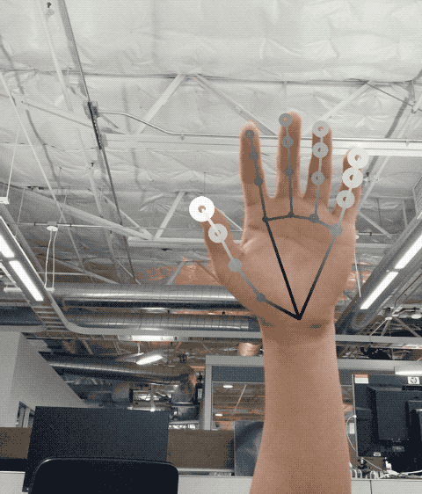
Frontend
Notes:
Explain that the gui on the screen is pretty much base level and it hasn't been integrated with the translator script at all

Slide 9
Functional Demo
FUNC1: Translate to English
2: Standalone Device
3: Translate to text and sound
4: Translate in various lighting conditions
5: Recognize diverse hands
6,7,8: Embedded Processor, Screen, Speaker Usage
PERF1: (A-Z, 0-9) and at least 10 basic signs
2: Translation delay under 5 seconds
3: Minimum 80% translation accuracy
4: Recognition within a 3-feet range

Slide 10
Functional Requirements
☑ 1: Translate to English
☑ 2: Standalone Device
☑ 3: Translate to text and sound
☑ 4: Translate in various lighting conditions
☑ 5: Recognize diverse hands
☑ 6,7,8: Embedded Processor, Screen, Speaker Usage

Slide 11
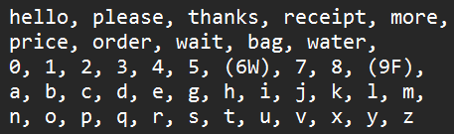
Performance Requirements 1
☑ 1: (A-Z, 0-9) and at least 10 basic signs
☑ 4: Recognition within a 3-feet range
All tests performed in the 3-feet operating region

Slide 12
Performance Requirements 2
☑ 2: Translation delay under 5 seconds
Average of 4.84 seconds per translation
☑ 3: Minimum 80% translation accuracy
95% for low brightness testing
99% for normal/high brightness testing
Inconsistency with some signs

Slide 13
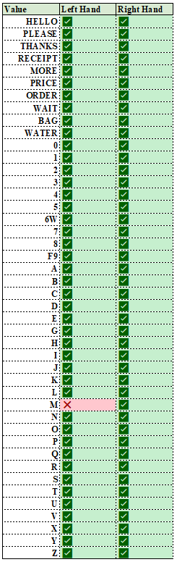
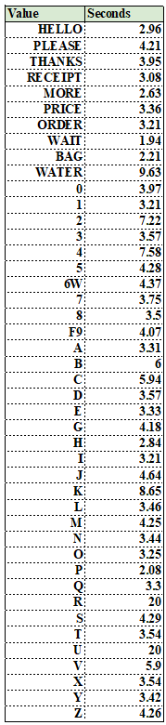
Test Results
Testing done in a high brightness ->
Time: Average of 4.84 seconds per translation
Distance: within 3 ft. of the camera
Inconsistency:
‘M’, ‘R’, ‘S’, ‘U’, ‘V’

Slide 14
Challenges Faced
Discernment of similar signs (‘6’ and ‘W’ & ‘9’ and ‘F’)
Solution: Gesture is labeled as ‘(6W)’ or ‘(9F)’ and an additional software layer to find the most contextually appropriate character
General Housing
Pre-Built housing + 3D printing additions

Slide 15
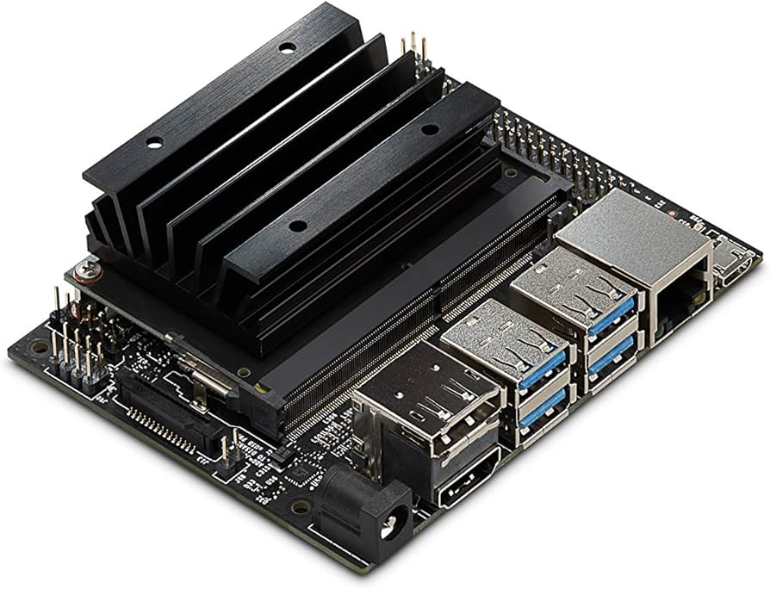
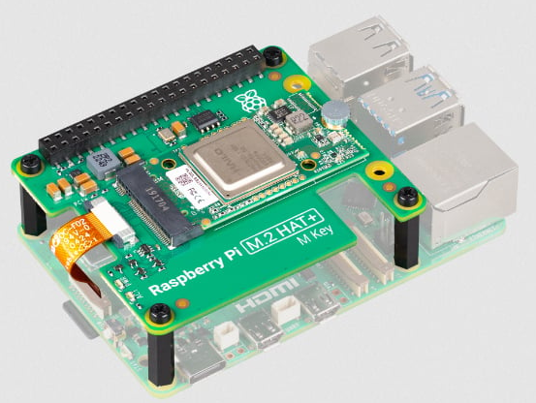
Remaining Issues + Future Implementations
GUI is aesthetic redesign of GUI
Spell-Checking
Optimizations to lower translation time
Upgrade in computational power for ML and further translation capabilities
Notes:
Since the signs 6 and W and 9 and F are similar, we used user context to differentiate between the similar signs

Slide 16
Conclusion
The ASL device exceeded initial goals in both accuracy and speed
Met all functional and performance requirements
Expanded translatable vocabulary for more complex conversations
Demonstrated a functional model of the device live

Slide 17
Thank you!

